Slide 1
Project presentation
Comparative Analysis of the Impact of Agricultural GDP and Oil Rent on Nigeria’s Economy
An economic Overview of Nigeria
Seeding Africa | FEMTECH Training Institute
Presentation by: Abbas Anifat Olohuntosin
The World bank DataBank (2000-2021)

Slide 2
Report Agenda
Literature Review Existing studies indicate that both agriculture and oil revenue contribute to Nigeria's economic growth; however, agriculture provides more stable and inclusive benefits, while excessive dependence on oil exposes the economy to volatility and external shocks.
Background Nigeria's economy has historically depended on agriculture and oil, with the discovery of crude oil shifting attention away from agriculture despite its continued importance in employment generation, food security, and economic stability
Aims To comparatively assess the impact of Agricultural GDP and Oil Revenue on Nigeria's economic performance by examining their trends, contributions, relationships, and the influence of inflation and exchange rate fluctuations between 2000 and 2021.
Scope of the Study The study examined the comparative impact of Agricultural GDP and Oil Revenue on Nigeria's economy from 2000 to 2021, using GDP Growth Rate, Inflation Rate, and Exchange Rate as key economic indicators.
Problem Statement Nigeria's heavy reliance on oil revenue has exposed the economy to external shocks and volatility, creating the need to assess whether agriculture provides a more sustainable contribution to economic performance.

Slide 3
Methodology/Workflow
Data Analysis Process
Brief explanation:
Secondary data from the World Bank were cleaned, analyzed, and visualized using Excel, SQL, Python, and Power BI to generate insights on the comparative impact of agriculture and oil revenue.
1
2
3
4
5
Data Collection
From the World Bank
Data Cleaning Using Excel
Data Organization Using SQL
Statistical Analysis Using Python
Dashboard Development Using Power BI

Slide 4
Key Findings
Study period (2000–2021)
22 Years
Agriculture Average
24.87%
Oil Rent AVG
10.82%
GDP Growth AVG
4.91%
22 Analyzed Years | Agriculture dominated 21 | oil revenue dominated 1 year.
Oil rents fluctuated considerably, declining from 22.05% in 2000 to approximately 6.25% in 2021.

Slide 5
Economic Performance Analysis
Strong Growth periods generated the highest GDP output.
Weak Growth periods maintained moderate economic activity.
Economic Decline was associated with the lowest GDP performance.
Sustained economic growth remains critical for improving Nigeria's overall economic output.

Slide 6
Trend and Comparative Analysis
Economic performance label | Decline | Strong Growth | Weak Growth
High Inflation Period
High Inflation | 20.00 | 40.00 | 40.00
Normal | 5.88 | 70.59 | 23.53
Explanation
Agriculture provided more consistent support to the economy, whereas oil revenue was heavily influenced by global market conditions.
Explanation
Lower and stable inflation was associated with stronger economic performance, while high inflation reduced economic growth outcomes.

Slide 7
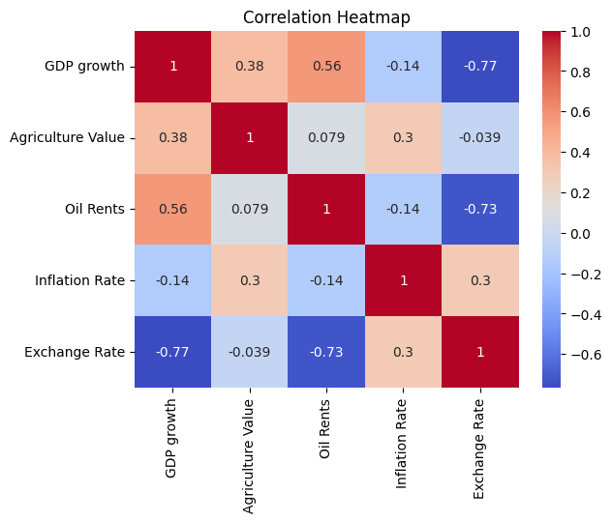
Correlation Analysis
Simple Interpretations
GDP Growth & Oil Revenue (0.56): Moderate positive relationship.
GDP Growth & Agriculture (0.38): Weak positive relationship.
GDP Growth & Exchange Rate (-0.77): Strong negative relationship.
Oil Revenue & Exchange Rate (-0.73): Strong negative relationship.
Agriculture & Inflation (0.30): Weak positive relationship.
Agriculture & Oil Revenue (0.079): Very weak relationship.
Insight: Exchange rate had the strongest influence on economic performance, while agriculture provided a more stable contribution than the volatile oil sector.
each other

Slide 8
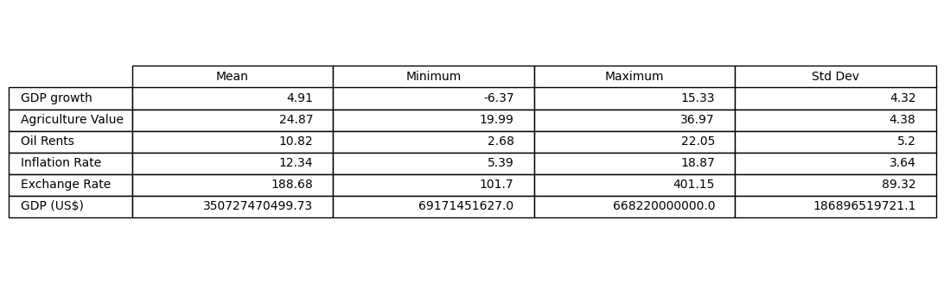
Descriptive Statistics
Summary
The results indicate moderate economic growth during the study period, accompanied by relatively stable sectoral contributions and inflation levels. However, the exchange rate exhibited substantial fluctuations, reflecting significant currency volatility over time. Overall, the findings suggest that while some economic indicators remained fairly consistent, others experienced considerable variation, highlighting the dynamic nature of Nigeria's economy between 2000 and 2021.

Slide 9
Limitations of the Study
Dependence on Secondary Data
The study relied entirely on data obtained from the World Bank and National Bureau of Statistics (NBS). Therefore, the accuracy of the findings depends on the reliability of these sources.
Limited Study Period
The analysis covered only the period from 2000 to 2021. Economic events occurring before or after this period were not considered.
Restricted Variables
The study focused on Agricultural GDP, Oil Revenue, GDP Growth Rate, Inflation Rate, and Exchange Rate. Other important economic variables that may influence growth were excluded
Historical Data Constraints
The findings are based on historical trends and relationships, which may not fully reflect future economic conditions or policy changes

Slide 10
Conclusion and Recommendation
Recommendations
1. Increase Investment in Agriculture
Government should invest more in agricultural infrastructure, mechanization, irrigation systems, and modern farming techniques to improve productivity and output.
2. Promote Economic Diversification
Efforts should be intensified to reduce overdependence on oil revenue by developing agriculture and other productive sectors of the economy.
3. Improve Access to Agricultural Finance
Farmers and agribusinesses should be provided with affordable loans and financial support to encourage expansion and innovation.
4. Maintain Macroeconomic Stability
Policies aimed at controlling inflation and stabilizing exchange rates should be strengthened to create a favorable environment for economic growth.
Conclusion
The study found that agriculture contributed more steadily to Nigeria’s economic growth between 2000 and 2021 compared to oil revenue, which was highly volatile due to global price fluctuations. While oil remains important for foreign exchange and government revenue, agriculture emerged as a more stable driver of growth. Overall, the results emphasize the need for economic diversification and stronger support for the agricultural sector to achieve sustainable growth.

Slide 11
Thank You
Questions and Discussions…………….
Seeding Africa | FEMTECH Training Institute
2026

